Slide 1
CE 395 R5- Data Mining Data

Slide 2
What is Data?
Attributes
Collection of data objects and their attributes
An attribute is a property or characteristic of an object
Examples: eye color of a person, temperature, etc.
Attribute is also known as variable, field, characteristic, or feature
A collection of attributes describe an object
Object is also known as record, point, case, sample, entity, or instance
Objects

Slide 3
Types of Attributes
Attribute Type
Description
Examples
Operations
Nominal
The values of a nominal attribute are just different names, i.e., nominal attributes provide only enough information to distinguish one object from another. (=, ≠)
zip codes, employee ID numbers, eye color, sex: {male, female}
mode, entropy, contingency correlation, χ² test
Ordinal
The values of an ordinal attribute provide enough information to order objects. (<, >)
hardness of minerals, {good, better, best}, grades, street numbers
median, percentiles, rank correlation, run tests, sign tests
Interval
For interval attributes, the differences between values are meaningful, i.e., a unit of measurement exists. (+, - )
calendar dates, temperature in Celsius or Fahrenheit
mean, standard deviation, Pearson's correlation, t and F tests
Ratio
For ratio variables, both differences and ratios are meaningful. (*, /)
monetary quantities, counts, age, mass, length, electrical current
geometric mean, harmonic mean, percent variation

Slide 4
Discrete and Continuous Attributes
Discrete Attribute
Has only a finite or countable infinite set of values
Examples: zip codes, counts, or the set of words in a collection of documents
Often represented as integer variables.
Note: binary attributes are a special case of discrete attributes
Continuous Attribute
Has real numbers as attribute values
Examples: temperature, height, or weight.
Practically, real values can only be measured and represented using a finite number of digits.
Continuous attributes are typically represented as floating-point variables.

Slide 5
Types of data sets
Record
Data Matrix
Document Data
Transaction Data
Graph
World Wide Web
Molecular Structures
Ordered
Spatial Data
Temporal Data
Sequential Data
Genetic Sequence Data

Slide 6
Record Data
Data that consists of a collection of records, each of which consists of a fixed set of attributes

Slide 7
Data Matrix
If data objects have the same fixed set of numeric attributes, then the data objects can be thought of as points in a multi-dimensional space, where each dimension represents a distinct attribute
Such data set can be represented by an m by n matrix, where there are m rows, one for each object, and n columns, one for each attribute

Slide 8
Document Data
Each document becomes a `term' vector,
each term is a component (attribute) of the vector,
the value of each component may be the number of times the corresponding term occurs in the document.

Slide 9
Transaction Data
A special type of record data, where
each record (transaction) involves a set of items.
For example, consider a grocery store. The set of products purchased by a customer during one shopping trip constitute a transaction, while the individual products that were purchased are the items.

Slide 10
Graph Data
Examples: Generic graph and HTML Links

Slide 11
Chemical Data
Benzene Molecule: C₆H₆

Slide 12
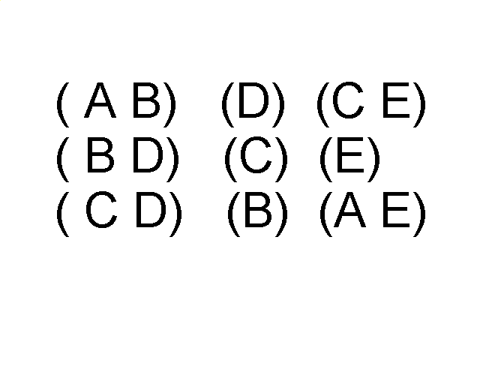
Ordered Data
Sequences of transactions
Items/Events
An element of the sequence

Slide 13
Ordered Data
DNA sequencing: the process of determining the exact order of the 3 billion chemical building blocks (called bases and abbreviated A, T, C, and G) that make up the DNA of the 24 different human chromosomes

Slide 14
Ordered Data
Spatio-Temporal Data
Average Monthly Temperature of land and ocean

Slide 15
Data Quality
What kinds of data quality problems exist?
Noise and outliers
missing values
duplicate data
How can we detect problems with the data?
What can we do about these problems?

Slide 16
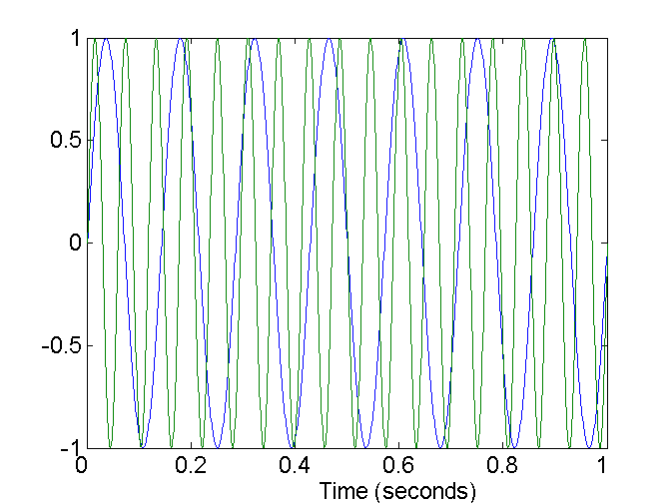
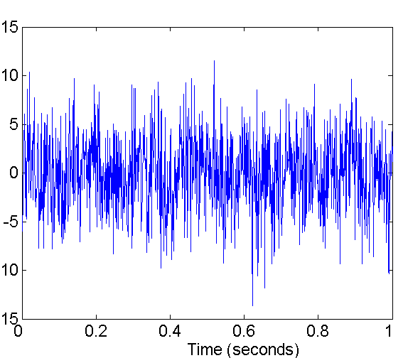
Noise
Noise refers to modification of original values
Examples: distortion of a person’s voice when talking on a poor phone and “snow” on television screen
Two Sine Waves
Two Sine Waves + Noise

Slide 17
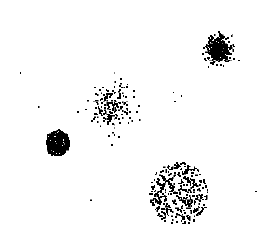
Outliers
Outliers are data objects with characteristics that are considerably different than most of the other data objects in the data set

Slide 18
Missing Values
Reasons for missing values
Information is not collected (e.g., people decline to give their age and weight)
Attributes may not be applicable to all cases (e.g., annual income is not applicable to children)

Slide 19
Duplicate Data
Data set may include data objects that are duplicates, or almost duplicates of one another
Major issue when merging data from heterogeneous sources
Examples:
Same person with multiple email addresses

Slide 20
Why Data Preprocessing?
Data in the real world is dirty
incomplete: lacking attribute values, lacking certain attributes of interest, or containing only aggregate data
noisy: containing errors or outliers
inconsistent: containing discrepancies in codes or names
No quality data, no quality mining results!
Quality decisions must be based on quality data

Slide 21
Major Tasks in Data Preprocessing
Data cleaning
Fill in missing values, smooth noisy data, identify or remove outliers, and resolve inconsistencies
Data integration
Integration of multiple databases, data cubes, or files
Data transformation
Normalization and aggregation
Data reduction
Obtains reduced representation in volume but produces the same or similar analytical results
Data discretization
Part of data reduction but with particular importance, especially for numerical data

Slide 22
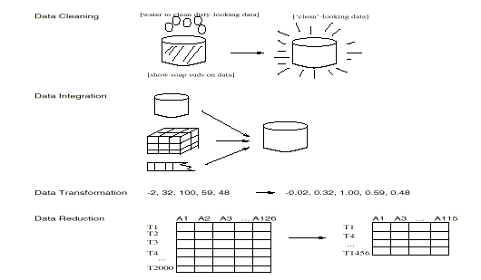
Forms of data preprocessing

Slide 23
Data Cleaning
Data cleaning tasks:
Fill in missing values
Identify outliers and smooth out noisy data
Correct inconsistent data

Slide 24
Missing Data
Data is not always available
E.g., many records have no recorded value for several attributes, such as customer income in sales data
Missing data may be due to:
equipment malfunction
inconsistent with other recorded data and thus deleted
data not entered due to misunderstanding
certain data may not be considered important at the time of entry
not register history or changes of the data
Missing data may need to be inferred

Slide 25
How to Handle Missing Data?
Ignore the record: usually done when class label is missing (assuming the tasks in classification—not effective when the percentage of missing values per attribute varies considerably.
Fill in the missing value manually: tedious + infeasible?
Use a global constant to fill in the missing value: e.g., “unknown”, a new class?!
Use the attribute mean to fill in the missing value
Use the attribute mean for all samples belonging to the same class to fill in the missing value: smarter
Use the most probable value to fill in the missing value: inference-based such as Bayesian formula or decision tree

Slide 26
Noisy Data
Noise: random error or variance in a measured variable
Incorrect attribute values may due to
faulty data collection instruments
data entry problems
data transmission problems
technology limitation
inconsistency in naming convention

Slide 27
How to Handle Noisy Data?
Binning method:
first sort data and partition into bins
then one can smooth by bin means, smooth by bin median, smooth by bin boundaries, etc.
Clustering
detect and remove outliers
Combined computer and human inspection
detect suspicious values and check by human
Regression
smooth by fitting the data into regression functions

Slide 28
Data Integration
Data integration:
combines data from multiple sources into a coherent store
Schema integration
integrate metadata from different sources
Entity identification problem: identify real world entities from multiple data sources, e.g., A.cust-id ≡ B.cust-#
Detecting and resolving data value conflicts
for the same real world entity, attribute values from different sources are different
possible reasons: different representations, different scales, e.g., metric vs. British units

Slide 29
Handling Redundant Data in Data Integration
Redundant data occur often when integration of multiple databases
The same attribute may have different names in different databases
One attribute may be a “derived” attribute in another table, e.g., annual revenue
Careful integration of the data from multiple sources may help reduce/avoid redundancies and inconsistencies and improve mining speed and quality

Slide 30
Data Transformation
Smoothing: remove noise from data
Aggregation: summarization, data cube construction
Generalization: concept hierarchy climbing
Normalization: scaled to fall within a small, specified range
min-max normalization
z-score normalization
normalization by decimal scaling
Attribute/feature construction
New attributes constructed from the given ones

Slide 31
Data Preprocessing: Generic Approaches
Aggregation
Sampling
Dimensionality Reduction
Feature subset selection
Feature creation
Discretization and Binarization
Attribute Transformation

Slide 32
Aggregation
Combining two or more attributes (or objects) into a single attribute (or object)
Reduce the number of attributes or objects
Change of scale
Cities aggregated into regions, states, countries, etc
More “stable” data
Aggregated data tends to have less variability

Slide 33
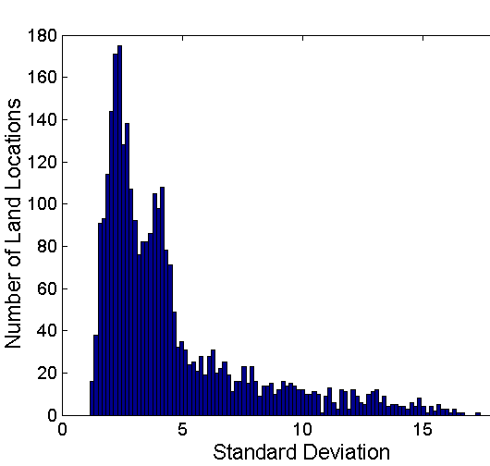
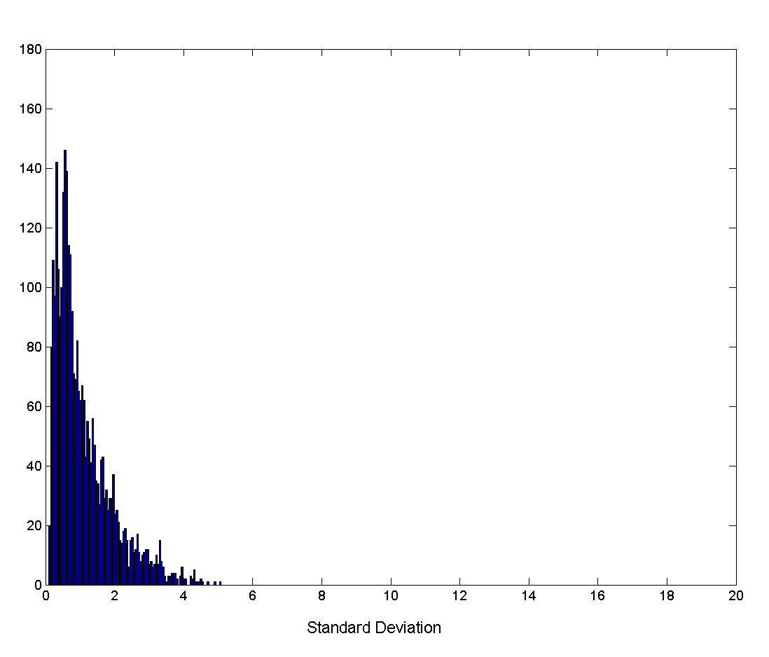
Aggregation
Variation of Precipitation in Australia
Standard Deviation of Average Monthly Precipitation
Standard Deviation of Average Yearly Precipitation

Slide 34
Sampling
Sampling is one of the main techniques employed for data selection.
Statisticians sample because obtaining the entire set of data of interest is too expensive or time consuming.
Sampling is used in data mining because processing the entire set of data of interest is too expensive or time consuming.

Slide 35
Sampling (2)
The key principle for effective sampling is the following:
using a sample will work almost as well as using the entire data sets, if the sample is representative
A sample is representative if it has approximately the same property (of interest) as the original set of data

Slide 36

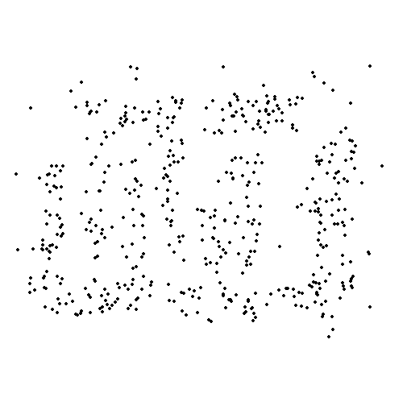
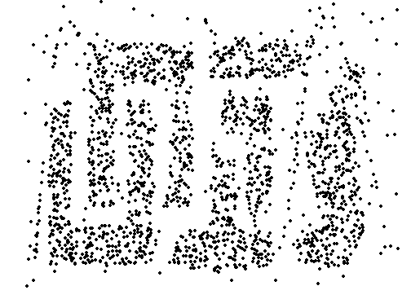
Sample Size
8000 points 2000 Points 500 Points

Slide 37
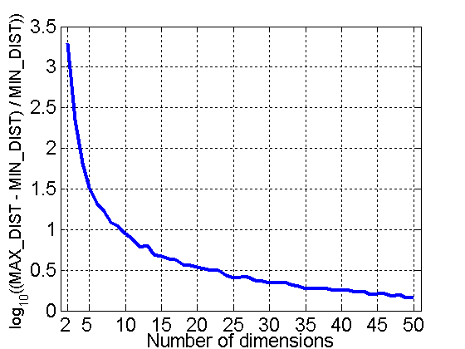
Curse of Dimensionality
When dimensionality increases, data becomes increasingly sparse in the space that it occupies
Definitions of density and distance between points, which is critical for clustering and outlier detection, become less meaningful
Randomly generate 500 points
Compute difference between max and min distance between any pair of points

Slide 38
Dimensionality Reduction
Purpose:
Avoid curse of dimensionality
Reduce amount of time and memory required by data mining algorithms
Allow data to be more easily visualized
May help to eliminate irrelevant features or reduce noise
Techniques
Principle Component Analysis
Singular Value Decomposition
Others

Slide 39
Feature Subset Selection
Another way to reduce dimensionality of data
Redundant features
duplicate much or all of the information contained in one or more other attributes
Example: purchase price of a product and the amount of sales tax paid
Irrelevant features
contain no information that is useful for the data mining task at hand
Example: students' ID is often irrelevant to the task of predicting students' GPA

Slide 40
Feature Subset Selection
Techniques:
Brute-force approach:
Try all possible feature subsets as input to data mining algorithm
Embedded approaches:
Feature selection occurs naturally as part of the data mining algorithm
Filter approaches:
Features are selected before data mining algorithm is run
Wrapper approaches:
Use the data mining algorithm as a black box to find best subset of attributes

Slide 41
Feature Creation
Create new attributes that can capture the important information in a data set much more efficiently than the original attributes
Three general methodologies:
Feature Extraction
domain-specific
Mapping Data to New Space
Feature Construction
combining features

Slide 42


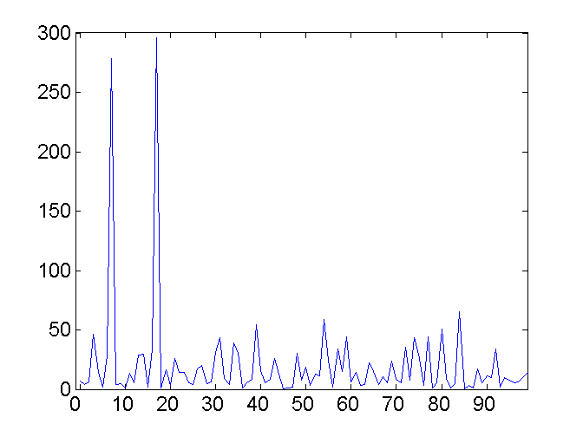
Mapping Data to a New Space
Fourier transform
Wavelet transform

Slide 43
Discretization
Discretization of continuous attributes:
Transform continuous attribute to categorical attribute
Divide the range of a continuous attribute into intervals in order to reduce data size
Subtasks:
Decide how many categories to have
Determine how to map the values of the continuous values to these categories

Slide 44
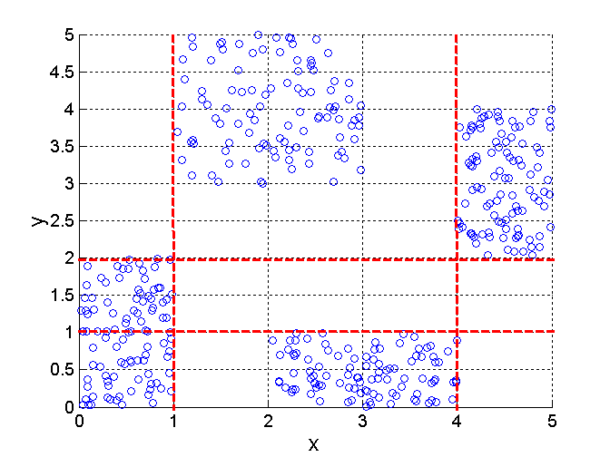
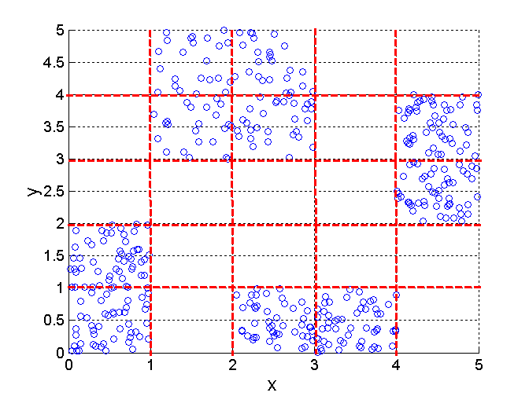
Discretization Using Class Labels
3 categories for both x and y
5 categories for both x and y

Slide 45
Data Transformation: Normalization
min-max normalization
z-score normalization
normalization by decimal scaling
Where j is the smallest integer such that Max(| |)<1

Slide 46
Similarity and Dissimilarity
Similarity
Numerical measure of how alike two data objects are.
Is higher when objects are more alike.
Often falls in the range [0,1]
Dissimilarity
Numerical measure of how different are two data objects
Lower when objects are more alike
Minimum dissimilarity is often 0
Upper limit varies
Distance: special class of dissimilarity
Proximity refers to a similarity or dissimilarity

Slide 47
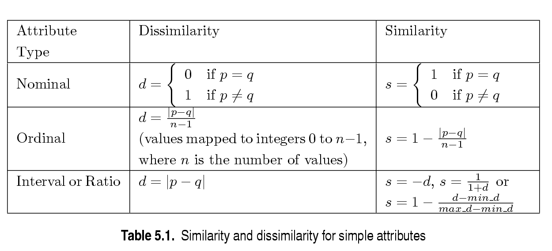
Similarity/Dissimilarity for Simple Attributes
p and q are the attribute values for two data objects.

Slide 48
Euclidean Distance
Euclidean Distance
Where n is the number of dimensions (attributes) and p_{k} and q_{k} are, respectively, the k^{th} attributes (components) or data objects p and q.
Standardization is necessary, if scales differ.

Slide 49
Euclidean Distance
Distance Matrix

Slide 50
Minkowski Distance
Minkowski Distance is a generalization of Euclidean Distance
Where r is a parameter, n is the number of dimensions (attributes) and p_{k} and q_{k} are, respectively, the kth attributes (components) or data objects p and q.

Slide 51
Minkowski Distance: Examples
r = 1. City block (Manhattan, taxicab, L₁ norm) distance.
A common example of this is the Hamming distance, which is just the number of bits that are different between two binary vectors
r = 2. Euclidean distance
r → ∞. “supremum” (L_{max} norm, L∞ norm) distance.
This is the maximum difference between any component of the vectors
Do not confuse r with n, i.e., all these distances are defined for all numbers of dimensions.

Slide 52
Minkowski Distance
Distance Matrices

Slide 53
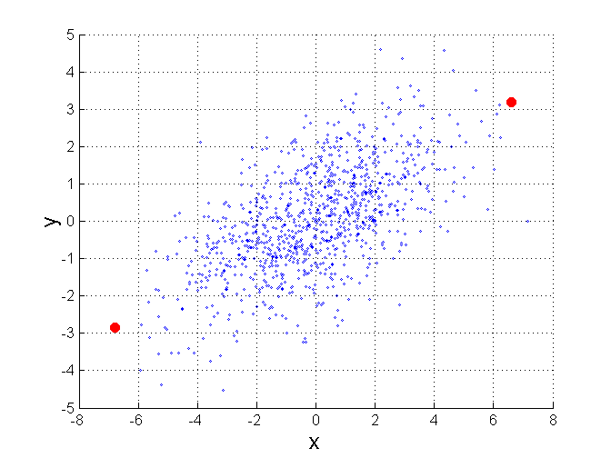
Mahalanobis Distance
Σ is the covariance matrix of the input data X
For red points, the Euclidean distance is 14.7, Mahalanobis distance is 6.

Slide 54
Common Properties of a Distance
Distances, such as the Euclidean distance, have some well known properties.
d(p, q) ≥ 0 for all p and q and d(p, q) = 0 only if p = q. (Positive definiteness)
d(p, q) = d(q, p) for all p and q. (Symmetry)
d(p, r) ≤ d(p, q) + d(q, r) for all points p, q, and r. (Triangle Inequality)
where d(p, q) is the distance (dissimilarity) between points (data objects), p and q.

Slide 55
Common Properties of a Similarity
Similarities, also have some well known properties.
s(p, q) = 1 (or maximum similarity) only if p = q.
s(p, q) = s(q, p) for all p and q. (Symmetry)
where s(p, q) is the similarity between points (data objects), p and q.

Slide 56
Similarity Between Binary Vectors
Common situation is that objects, p and q, have only binary attributes
Compute similarities using the following quantities
M₀₁ = the number of attributes where p was 0 and q was 1
M₁₀ = the number of attributes where p was 1 and q was 0
M₀₀ = the number of attributes where p was 0 and q was 0
M₁₁ = the number of attributes where p was 1 and q was 1
Simple Matching and Jaccard Coefficients
SMC = number of matches / number of attributes
= (M₁₁ + M₀₀) / (M₀₁ + M₁₀ + M₁₁ + M₀₀)
J = number of 11 matches / number of not-both-zero attributes values
= (M₁₁) / (M₀₁ + M₁₀ + M₁₁)

Slide 57
Cosine Similarity
If d₁ and d₂ are two document vectors, then
cos( d₁, d₂ ) = (d₁ • d₂) / ||d₁|| ||d₂|| ,
where • indicates vector dot product and || d || is the length of vector d.
Example:
d₁ = 3 2 0 5 0 0 0 2 0 0
d₂ = 1 0 0 0 0 0 0 1 0 2
d₁ • d₂= 3*1 + 2*0 + 0*0 + 5*0 + 0*0 + 0*0 + 0*0 + 2*1 + 0*0 + 0*2 = 5
||d₁|| = (3*3+2*2+0*0+5*5+0*0+0*0+0*0+2*2+0*0+0*0)^{0.5} = (42) ^{0.5} = 6.481
||d₂|| = (1*1+0*0+0*0+0*0+0*0+0*0+0*0+1*1+0*0+2*2) ^{0.5} = (6) ^{0.5} = 2.245
cos( d₁, d₂ ) = .3150

Slide 58
Correlation
Correlation measures the linear relationship between objects
To compute correlation, we standardize data objects, p and q, and then take their dot product

Slide 59
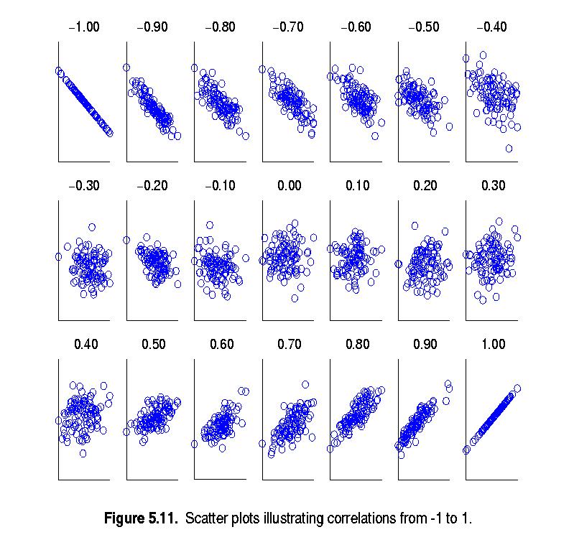
Visually Evaluating Correlation
Scatter plots showing the similarity from –1 to 1.

Slide 60
Density
Density-based clustering require a notion of density
Examples:
Euclidean density
Euclidean density = number of points per unit volume
Probability density
Graph-based density

Slide 61
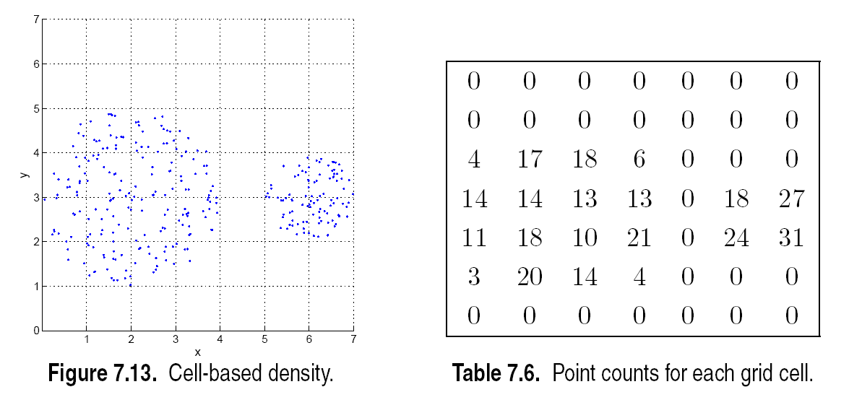
Euclidean Density – Cell-based
Simplest approach is to divide region into a number of rectangular cells of equal volume and define density as # of points the cell contains

Slide 62
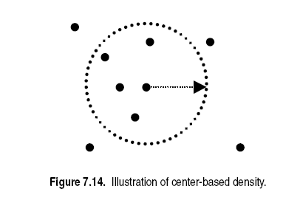
Euclidean Density – Center-based
Euclidean density is the number of points within a specified radius of the point

